Slide 1
Relativity

Slide 2
Page Set up
Set up the first page of every lesson like this and rule a column line for every page after the first page that is used during the lesson.
Focus: State the Chapter Number, Title and the page numbers. (3 lines).
Keywords: During the lesson write out your own keywords used during the lesson. (8 lines)
Context: During the lesson write in this section what this topic relates to in the ‘real’ world. How is this content used to better society? (5 lines)

Slide 3
Einstein's Special Theory of Relativity
Chapter 6.2 Pages 272 - 293

Slide 4
Einstein’s Theory of Relativity
Need to consider;
Speed and Newtons Laws
Frame of Reference
Galileo’s Principle of Relativity
The Speed of Light as a constant
Maxwell’s Conundrum
Time Restraints/Considerations (Dilation)
Einstein's Theory of Special Relativity

Slide 5
Key Aspects
Average Speed v = d
t
Newtons First Law: a body will either remain at rest or continue with constant speed in a straight line (i.e. constant velocity) unless acted on by a net force.
Newtons Second Law: the acceleration “a” of a body is directly proportional to the net force acting on it, ΣF, and indirectly proportional to its mass, “m”. Hence F = ma

Slide 6
Key Aspects
Hence the principle of relativity is that constant motion cannot be detected unless we have a frame of reference to compare it to.
Am I stationary?
What are you basing this reference on?

Slide 7
Inertial Frame of Reference
Inertial frame of reference is any reference point that is not accelerating. These include;
Any frame of reference that is at rest
Any frame of reference which is moving at a constant velocity
Any frame of reference which is in a stable, constant orbital speed.

Slide 8
Galileo’s Principle of Relativity
Example 6.2a: Classify each of the following as an inertial or non-inertial frame of reference and explain your choice.
The Earth
The classroom
A plane in level, constant flight
A plane on a steep climb
The school bus turning into a corner
A roller coaster
A spaceship in geostationary orbit

Slide 9
Galileo’s Principle of Relativity
In our normal everyday experience we consider motion relative to the ground and we consider the ground as a stationary frame of reference.
Galileo's Principle of Relativity.
All motion is relative to some particular frame of reference, but there can be no frame of reference that has an absolute zero velocity.
Hence
x = x’ + v Δt

Slide 10
Galileo’s Principle of Relativity
Galileo and Newton believed zero velocity is no different, in principle, to any other velocity – Principle of Inertia (The velocity of a body remains constant unless the body is acted upon by an external force).

Slide 11
Galileo’s Principle of Relativity
Imagine you are in a train carriage. No windows and no view of the outside world. The only reason you know you are moving is because you can feel it. But what is it you are feeling?
You are feeling the initial take-off; Newtons first law - The velocity of a body remains constant unless the body is acted upon by an external force. The force is felt.

Slide 12
Galileo’s Principle of Relativity
You are feeling the friction between the tracks and the train (the click-clack and rattle and bump).
But if you wake up from unconsciousness after the train reaches constant velocity and their is a frictionless, smooth track, would you feel motion?
No, as everything relative to you (and the train) is moving, but you are isolated from it, so relative to you nothing is happening. What if there was a window?

Slide 13
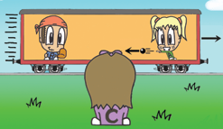
Galileo’s Principle of Relativity
30 m s⁻¹
Angela and Bill are in a moving train, while Clare observes from a stationary position, relative to the viewer of the picture.
10 m s⁻¹
Angela throws the ball at the same speed as Bill, but from Clare’s (and our) vantage point, it seems to be travelling slower and in fact it can be thrown such that it does not seem to move at all, relative to our position.
However, to Angela and Bill, the ball seems to be thrown at the same speed.

Slide 14
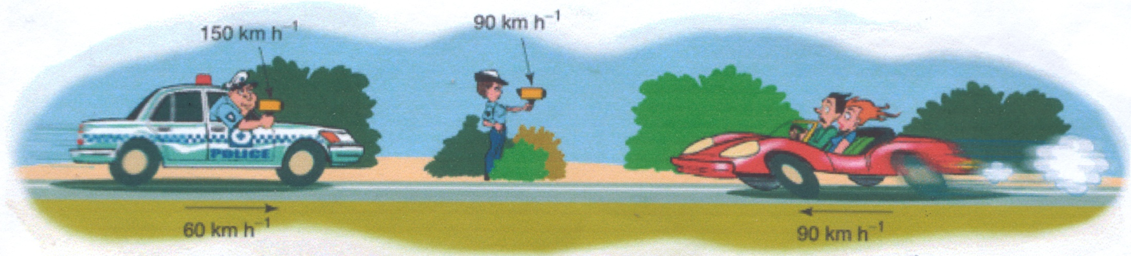
Galileo’s Principle of Relativity
Example 6.2b: Consider two police officers measuring the speed of a car, as shown below.
One is pointing her radar gun at the approaching sports car from her stationary position on the roadside and measures the sports car speed to 90 km h⁻¹.

Slide 15
Galileo’s Principle of Relativity
The other officer is holding his radar gun out of the window of his police car as he is driving towards the sports car at 60 km h⁻¹. He measures the speed of the sports car to be 150 km h⁻¹.
Which measurement is correct? And why?

Slide 16
Galileo’s Principle of Relativity
Example 6.2c: Sam is sitting on a bus moving at 50km h⁻¹ due West. He gets up and moves towards the front of the bus at 2 km h⁻¹. At the same time there is a car travelling at 70 km h⁻¹ which passes the bus, travelling in the opposite direction. Determine Sam’s velocity relative to:
the bus
the ground
the car

Slide 17
Homework, Context & Keywords
Context: How is this content used to better society?
Understanding relative movement and motion, to better explain planetary motion.

Slide 18
Homework, Context & Keywords
Key Words
Newtons First Law
Newtons Second Law
Inertial Frame of Reference
Frame of Reference
Galileo’s Principle

Slide 19
Homework, Context & Keywords
Homework
Complete all questions from Set 6.2 - due first lesson next week.
Read Chapter 6.3, page 175-178 and answer
Q1, Set 6.3
by next lesson.

Slide 20
Page Set up
Set up the first page of every lesson like this and rule a column line for every page after the first page that is used during the lesson.
Focus: State the Chapter Number, Title and the page numbers. (3 lines).
Keywords: During the lesson write out your own keywords used during the lesson. (8 lines)
Context: During the lesson write in this section what this topic relates to in the ‘real’ world. How is this content used to better society? (5 lines)

Slide 21
Maxwell's’ Conundrum and Michelson-Morley Experiment
Chapter 6.3 Pages 175 - 178

Slide 22
History: The Speed of Light
In about 1675 Danish astronomer Ole Römer succeeded in showing that light had a finite speed.
Light was too fast for Earth-bound experiments (such as that attempted by Galileo) and so Römer decided to use the moons of Jupiter to prove the Light Theory.
The accepted value of the speed of light in a vacuum is now:
c = 2.997 924 58 × 10⁸ m s^{–1}

Slide 23
History: Light as a Particle
In 1687 Sir Isaac Newton published his book; Principia. In his book, time was the same for everything. All waves observed on Earth required a medium, and so light must need a medium also. This medium was called the “luminiferous aether”.
Problems;
It needed to be dense to account for the speed of light.
It needed to be insubstantial, because we can’t see it, feel it or detect it.

Slide 24
History: Electromagnetism
In 1873 James Maxwell found that electric and magnetic fields interact and travelled as “electromagnetic” radiation.
He proposed that light was an electromagnetic radiation in the same aether medium that caused the electric and magnetic fields to travel.

Slide 25
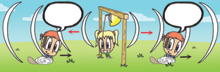
History: Maxwell’s Conundrum
Higher f :
speed of
v + u
Lower f :
speed of
v - u
As Bill runs towards or away from Angela, who is ringing the bell, the frequency will seem higher or lower. This is because this is based on Bill being the frame of reference.
Where v_{T} = f λ, where v_{T} = v + u or v – u
This was known as the Doppler effect.

Slide 26
History: Maxwell’s Conundrum
The relationship between sound and the motion of the receiver was known as the “Doppler” effect, discovered 22 years earlier, but unexplained until Maxwell in 1864.
He predicted that the speed of sound waves depends on the motion of the receiver relative to the source.
However, light had a constant speed, so he explained the “Doppler” effect of light with elegant mathematical equations. These equations did not account for the “aether”, and therefore was not widely accepted.

Slide 27
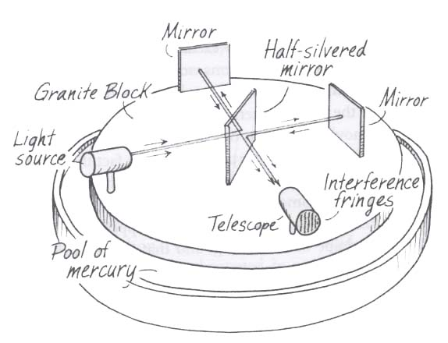
History: Michelson-Morley Experiment
In 1886 the experiment was designed to split light from the same source and send each beam on different paths, but travelling the same distance.
This was to confirm
the aether theory.

Slide 28
History: Michelson-Morley Experiment
One beam travelled in the same direction the Earth travels around the Sun and the other beam ran perpendicular to the first beams light path.
The two beams of light
were then directed
towards the same
receiver.

Slide 29
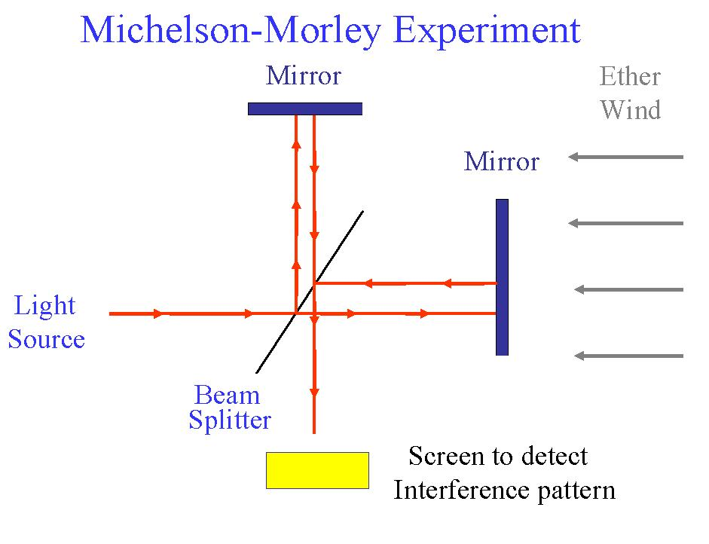

Slide 30
History: Michelson-Morley Experiment
If the “aether” were true then the light beams should reach the detector at different time intervals.
They were attempting to show, that like sound, light would show
varying path
differences for the
two beams and
also prove another
method in measuring
the speed of light.

Slide 31
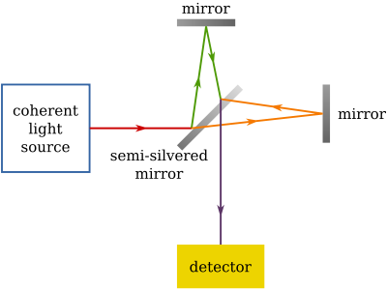
History: Michelson-Morley Experiment
This did not happen!!!
Maxwell believed his
theory of light to be
wrong, but Michelson-Morley
proved it right, and none
until Einstein could explain why.

Slide 32
History: Electrodynamics
In 1905 Albert Einstein used the mathematics and ideas of his predecessors on the theory of light, but chose to completely ignore the “aether” aspects of previous theories.
This meant the mathematics, that could not account for the aether, suddenly worked and made more sense.
From this his two important postulates arose; all motion is relative and speed of light is constant.

Slide 33
History: Replayed
In 1675, Ole Römer showed speed of light is constant.
In 1687 Sir Isaac Newton suggested light travels in an aether”.
In 1873 James Maxwell could not mathematically link the known theories of sound (Doppler Effect) to light.
In 1886, the Michelson-Morley Experiment suggested Maxwell was right and an aether was unlikely.
In 1905 Albert Einstein ignored the “aether” aspects of light travel. The mathematics now worked and made more sense. From this his two important postulates arose; all motion is relative and speed of light is constant.

Slide 34
Homework, Context & Keywords
Context: How is this content used to better society?
Understanding relative movement and motion, to better explain planetary motion.

Slide 35
Homework, Context & Keywords
Key Words
Maxwell's Conundrum
Michelson Morley's Experiment
Einstein's Corpostulates

Slide 36
Homework, Context & Keywords
Homework
Complete all questions from Set 6.3 - due first lesson next week.
Read Chapter 6.4, page 178-190 and answer
Q1, Q2 & Q3 Set 9.1
by next lesson.

Slide 37
Page Set up
Set up the first page of every lesson like this and rule a column line for every page after the first page that is used during the lesson.
Focus: State the Chapter Number, Title and the page numbers. (3 lines).
Keywords: During the lesson write out your own keywords used during the lesson. (8 lines)
Context: During the lesson write in this section what this topic relates to in the ‘real’ world. How is this content used to better society? (5 lines)

Slide 38
Einstein’s Special Relativity
Chapter 6.4 Pages 178 - 190

Slide 39
Time Considerations
The travelling through space and travelling through time are interrelated. In a sense, the faster we travel through space, the less we travel through time.
It is as though we move through what Einstein called spacetime at a constant rate, but the amount of space and the amount of time depend on who measures them.

Slide 40
Two Postulates
Consider there is no absolute frame of reference in the Universe, hence;
First postulate – the laws of Physics are the same in all frames of reference.
Second postulate – the speed of light is the same in all inertial frames of reference regardless on the relative motion of the source or the observer.

Slide 41
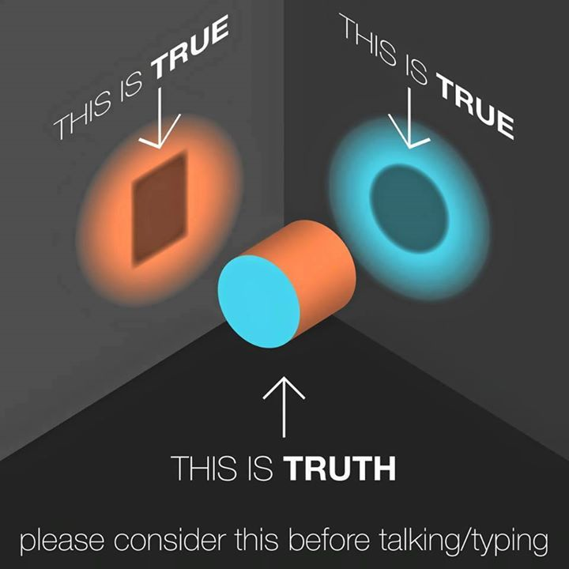
First Postulate
First postulate – the laws of Physics are the same in all inertial (non-accelerated) frames of reference.
The laws of physics
are the same
whether a particular
frame of reference
is stationary or in
uniform relative
motion to another.

Slide 42
Second Postulate
Second postulate – the speed of light is the same in all inertial frames of reference. Its value, c, is the same for all observers and does not depend on the relative motion of the source or the observer.
The speed of light is
always the same to an
observer, regardless
of any movement
towards or away
from the light source.

Slide 43
Einstein’s Special Theory of Relativity Outcomes
Time dilation
Length contraction
Relativistic momentum (next chapter)

Slide 44
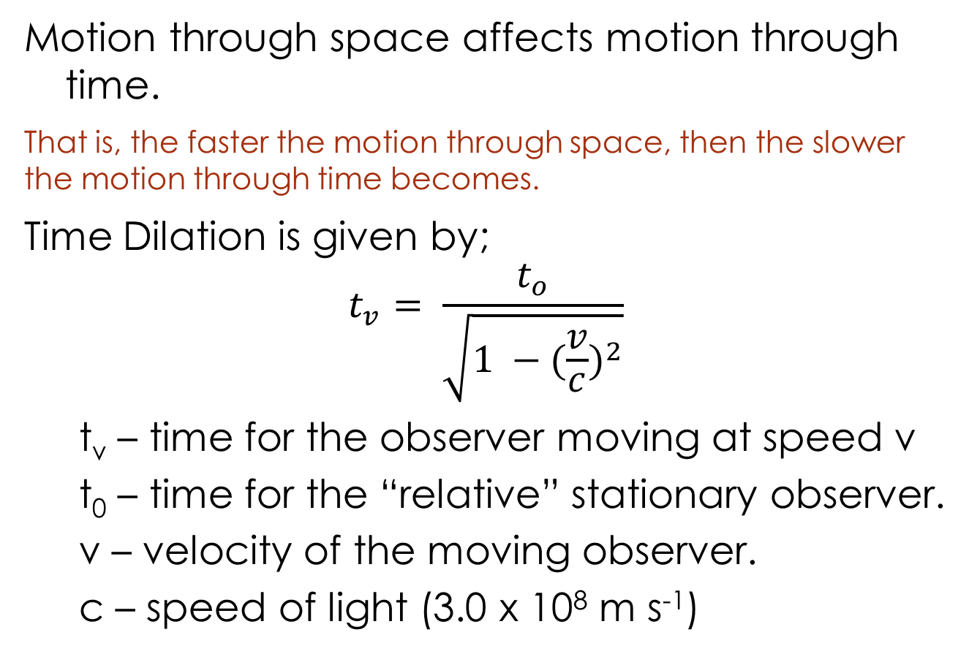
Time Dilation
Motion through space affects motion through time.
That is, the faster the motion through space, then the slower the motion through time becomes.
Time Dilation is given by;
$$t_{v}= \frac{t_{o}}{\sqrt{1 −{(\frac{v}{c})}^{2}}}$$
t_{v} – time for the observer moving at speed v
t₀ – time for the “relative” stationary observer.
v – velocity of the moving observer.
c – speed of light (3.0 x 10⁸ m s⁻¹)

Slide 45
Time Dilation
Example 6.4a: Einstein's ship is travelling to Alpha Centauri (4.2 light years away) from Earth. Einstein's twin Bertrand remains on Earth.
If Einstein only travels at 0.98 the speed of light, how long would it take him to travel to Alpha Centauri and back to Earth again, as seen by Bertrand?
For Einstein, what appears to be the time taken to travel to Alpha Centauri and back to Earth again?
Einstein and Bertrand meet up again on Earth after Einstein’s trip to Alpha Centauri. Who is older and by how much?

Slide 46
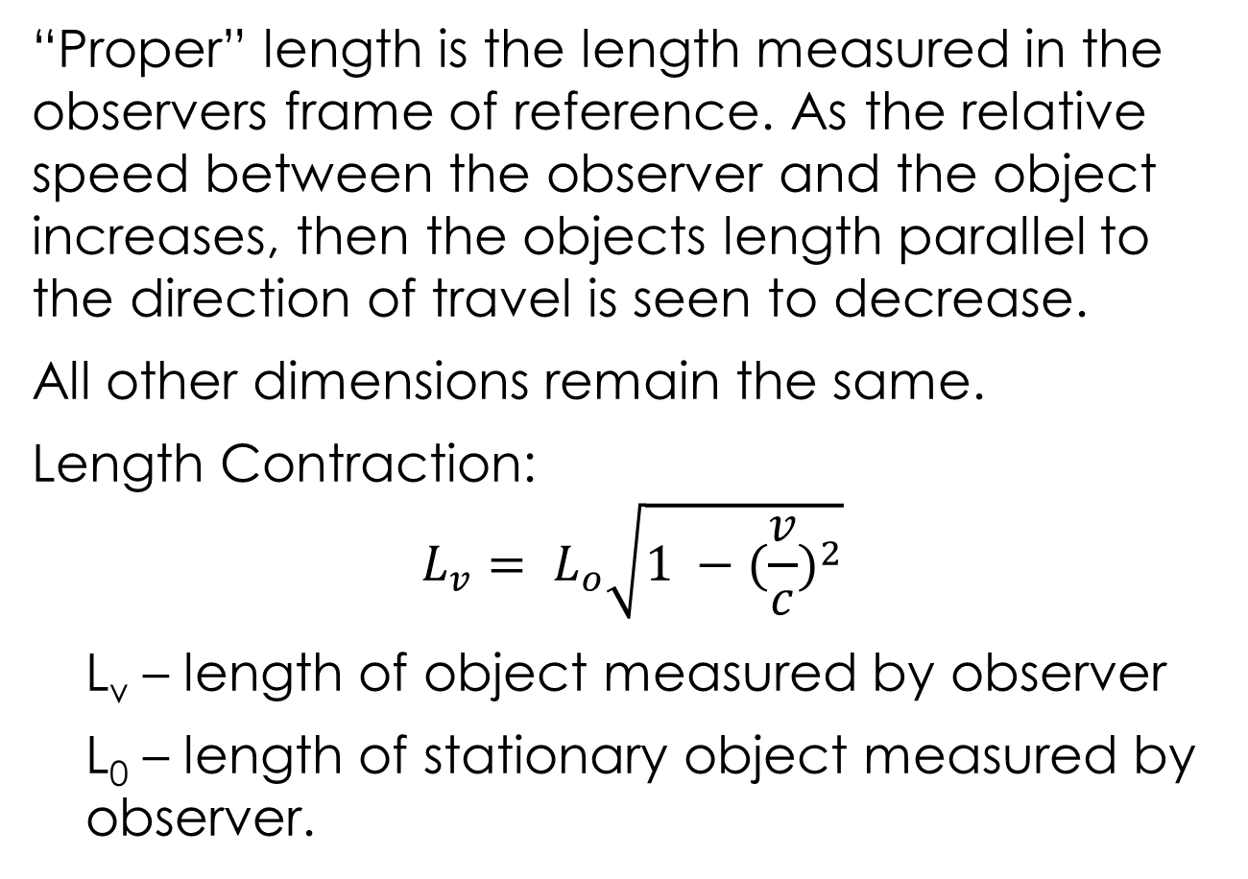
Length Contraction
“Proper” length is the length measured in the observers frame of reference. As the relative speed between the observer and the object increases, then the objects length parallel to the direction of travel is seen to decrease.
All other dimensions remain the same.
Length Contraction:
$$L_{v}= L_{o}\sqrt{1 −{(\frac{v}{c})}^{2}}$$
L_{v} – length of object measured by observer
L₀ – length of stationary object measured by observer.

Slide 47
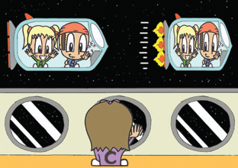
Length Contraction
Example 6.4b: Observers on Earth observe the length of a spacecraft travelling at 0.5c to have contracted. By what percentage of the “proper” length is the spacecraft contracted, according to the observers on Earth.
Example 6.4c: A box is thrown at
0.9c in the direction, as shown.
Which lengths, a, b and/or c
contracts?
b
c
a
0.9c

Slide 48
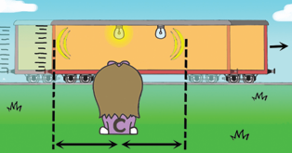
Simultaneity
Clare sees the light hit the back wall first.
This is because that wall is moving towards the light, whereas the front wall is moving away from the light and so the light will take longer to catch up to it.

Slide 49
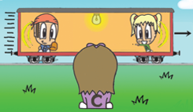
Simultaneity
Yet Angela and Bill saw the light flashes reach the ends of the carriage at the same time,
That is the concept behind relativity - two events that are simultaneous for one set of observers are not necessarily simultaneous for another, depending on the relative perspective.

Slide 50
Two Important Considerations
Einstein's theory of relativity assumes that only the one medium is involved when referencing these postulates.
Newtons theory of relativity is still correct, but is used for everyday and planetary motion. Where as Einstein's special theory of relativity is more relevant to high speeds, such as atomic and particulate motion.

Slide 51
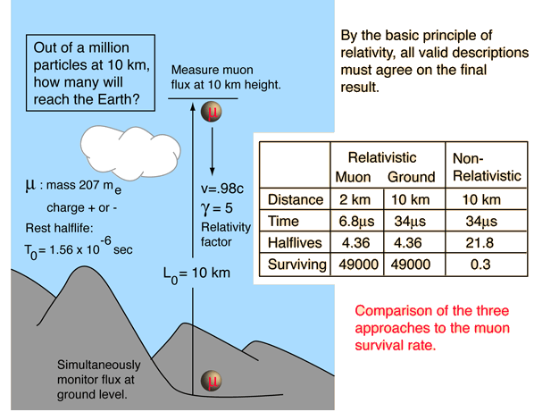
Muon Decay
The measurement of the flux of muons at the Earth's surface produced an early dilemma because many more are detected than
would be expected, based on
their short half-life of 1.56 μs.
This is a good example of the
application of
relativistic time
dilation to explain
the increased
particle range for
high-speed
particles.
The relativistic values proved closer to the observed values than the Newtonian method.

Slide 52
Homework, Context & Keywords
Context: How is this content used to better society?
Understanding relative movement and motion, to better explain planetary motion.

Slide 53
Homework, Context & Keywords
Key Words
Einstein's First Postulate
Einstein's Second Postulate
Time Dilation
Length Contraction
Simultaneity
Muon Decay

Slide 54
Homework, Context & Keywords
Homework
Complete all questions from Set 6.4 - due first lesson next week.
Read Chapter 6.5, page 191-198 and answer
Q1 & Q2 Set 6.5
by next lesson.

Slide 55
Page Set up
Set up the first page of every lesson like this and rule a column line for every page after the first page that is used during the lesson.
Focus: State the Chapter Number, Title and the page numbers. (3 lines).
Keywords: During the lesson write out your own keywords used during the lesson. (8 lines)
Context: During the lesson write in this section what this topic relates to in the ‘real’ world. How is this content used to better society? (5 lines)

Slide 56
Energy and Momentum
Chapter 6.5 Pages 191 - 198

Slide 57
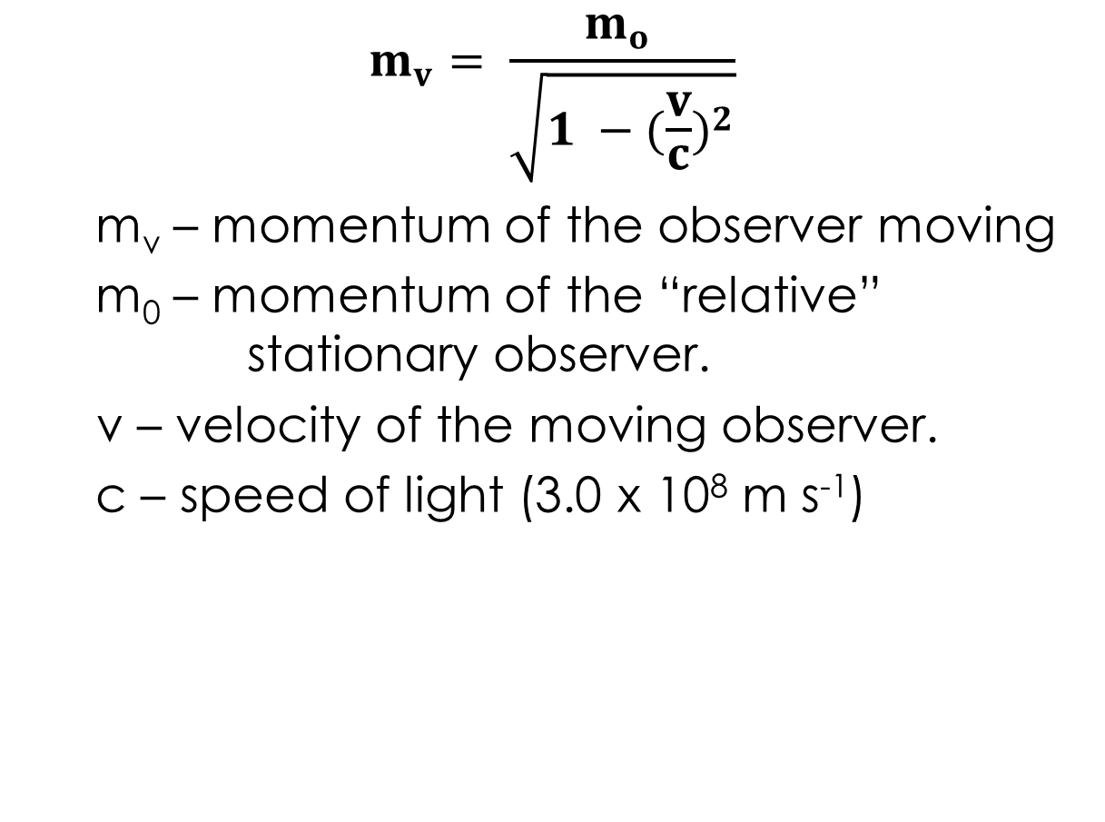
Relativistic Mass
$$m_{v}= \frac{m_{o} }{\sqrt{1 −{(\frac{v}{c})}^{2}}}$$
m_{v} – momentum of the observer moving
m₀ – momentum of the “relative”
stationary observer.
v – velocity of the moving observer.
c – speed of light (3.0 x 10⁸ m s⁻¹)

Slide 58
Einstein and the Theory of Special Relativity
Einstein discussed how time is affected by motion in space (space-time) and how mass and energy are related;
E = mc²
As an object approaches c, its momentum increases.
E = m c² = ½ m v² = ½ ρ v

Slide 59
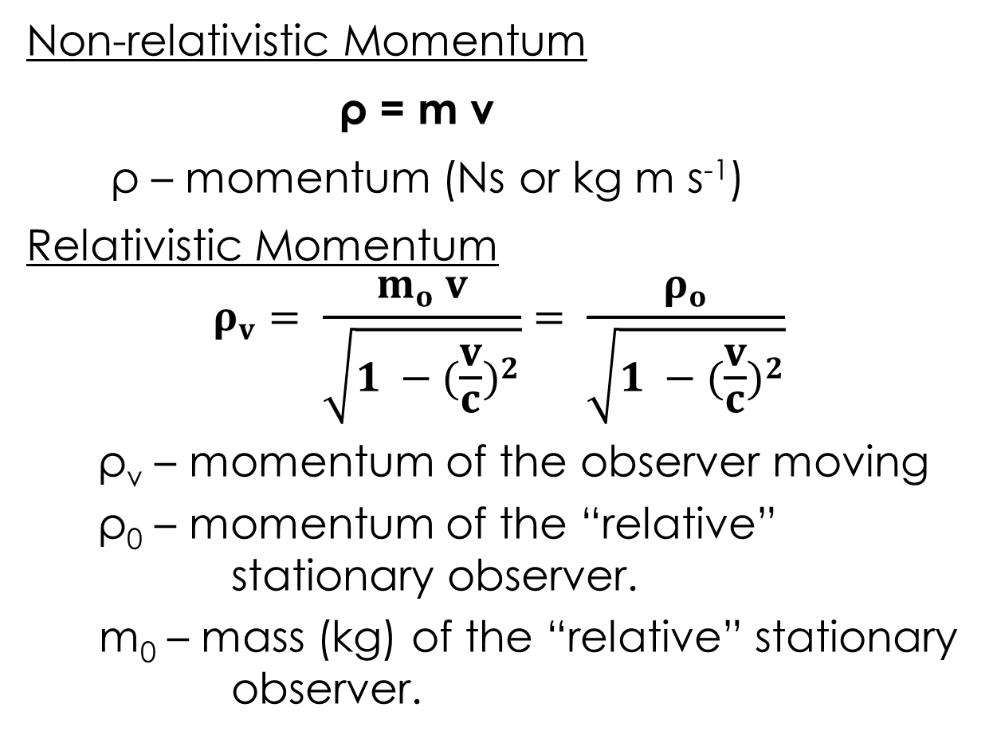
Relativistic Momentum
Non-relativistic Momentum
ρ = m v
ρ – momentum (Ns or kg m s⁻¹)
Relativistic Momentum
$$ρ_{v}= \frac{m_{o} v}{\sqrt{1 −{(\frac{v}{c})}^{2}}}= \frac{ρ_{o}}{\sqrt{1 −{(\frac{v}{c})}^{2}}}$$
ρ_{v} – momentum of the observer moving
ρ₀ – momentum of the “relative”
stationary observer.
m₀ – mass (kg) of the “relative” stationary
observer.

Slide 60
Relativistic Momentum
Example 6.5a: On Earth a car is fitted out to try and break the land speed record. The initial mass of the car is 2100 kg. The land speed record is 0.6 c (we are talking futuristic cars).
What is the relativistic momentum?
What is the relativistic mass?

Slide 61
Relativistic Mass
Travelling 100% of c, the momentum of a vehicle increases as the force of the engine increases the momentum. Near the speed of light the increase in momentum results in smaller and smaller increases in speed.
So no amount of impulse can accelerate the vehicle to the speed of light!

Slide 62
Relativistic Mass
One interpretation of this strange behaviour of momentum is that it appears that the inertial mass of the vehicle is increasing. (Good way to think of it, but not altogether true).
Thus, no matter how much force is applied, or work done, a rocket ship, or anything else, can never reach the speed of light. In fact only things without mass can travel at the speed of light, like photons.

Slide 63
Homework, Context & Keywords
Context: How is this content used to better society?
Understanding relative movement and motion, to better explain planetary motion.

Slide 64
Homework, Context & Keywords
Key Words
Relativistic Mass
Relativistic Momentum
Mass Defect
E = mc²

Slide 65
Homework, Context & Keywords
Homework
Complete all questions from Set 6.5 - due first lesson next week.
You Have Now Finished the Course…
All of it !!!!

